Slide 1
MapReduce and Hadoop Distributed File System

Slide 2
The Context: Big-data
Man on the moon with 32KB (1969); my laptop had 2GB RAM (2009)
Google collects 270PB data in a month (2007), 20000PB a day (2008)
2010 census data is expected to be a huge gold mine of information
Data mining huge amounts of data collected in a wide range of domains from astronomy to healthcare has become essential for planning and performance.
We are in a knowledge economy.
  Data is an important asset to any organization
  Discovery of knowledge; Enabling discovery; annotation of data
We are looking at newer
  programming models, and
  Supporting algorithms and data structures.
NSF refers to it as “data-intensive computing” and industry calls it “big-data” and “cloud computing”

Slide 3
Objective
To provide a simple introduction to:
  “The big-data computing” : An important advancement that has a potential to impact significantly the CS and undergraduate curriculum.
  A programming model called MapReduce for processing “big-data”
  A supporting file system called Hadoop Distributed File System (HDFS)
To encourage educators to explore ways to infuse relevant concepts of this emerging area into their curriculum.

Slide 4
The Outline
Introduction to MapReduce
From CS Foundation to MapReduce
MapReduce programming model
Hadoop Distributed File System
Relevance to Undergraduate Curriculum
Demo (Internet access needed)
Our experience with the framework
Summary
References

Slide 5
MapReduce

Slide 6
What is MapReduce?
MapReduce is a programming model Google has used successfully is processing its “big-data” sets (~ 20000 peta bytes per day)
  Users specify the computation in terms of a map and a reduce function,
  Underlying runtime system automatically parallelizes the computation across large-scale clusters of machines, and
  Underlying system also handles machine failures, efficient communications, and performance issues.
-- Reference: Dean, J. and Ghemawat, S. 2008. MapReduce: simplified data processing on large clusters. Communication of ACM 51, 1 (Jan. 2008), 107-113.

Slide 7
From CS Foundations to MapReduce
Consider a large data collection:
{web, weed, green, sun, moon, land, part, web, green,…}
Problem: Count the occurrences of the different words in the collection.
Lets design a solution for this problem;
  We will start from scratch
  We will add and relax constraints
  We will do incremental design, improving the solution for performance and scalability

Slide 8
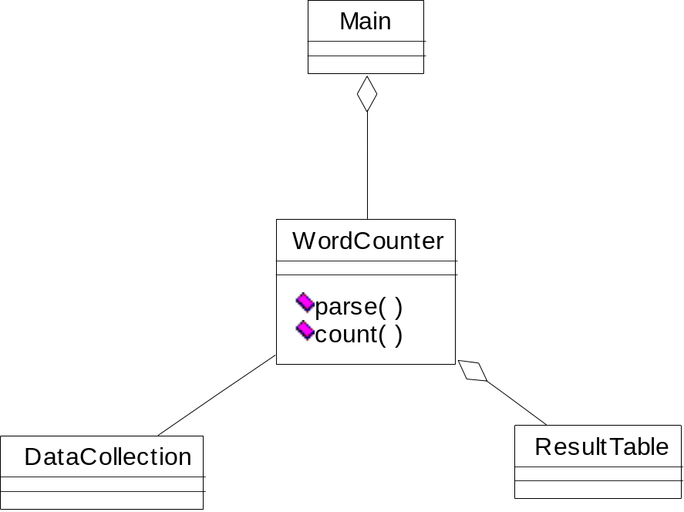
Word Counter and Result Table
{web, weed, green, sun, moon, land, part, web, green,…}
web | 2
weed | 1
green | 2
sun | 1
moon | 1
land | 1
part | 1
Data
collection

Slide 9

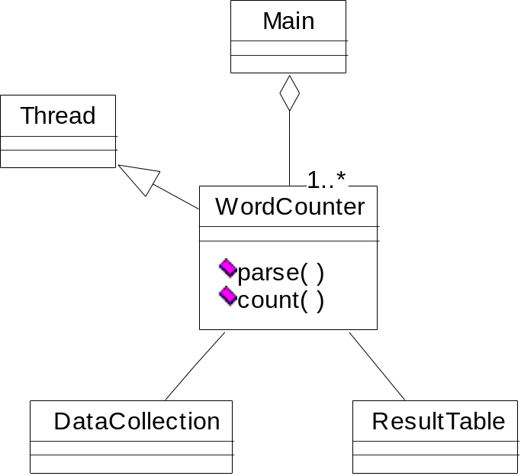
Multiple Instances of Word Counter
web | 2
weed | 1
green | 2
sun | 1
moon | 1
land | 1
part | 1
Data
collection
Observe:
Multi-thread
Lock on shared data

Slide 10
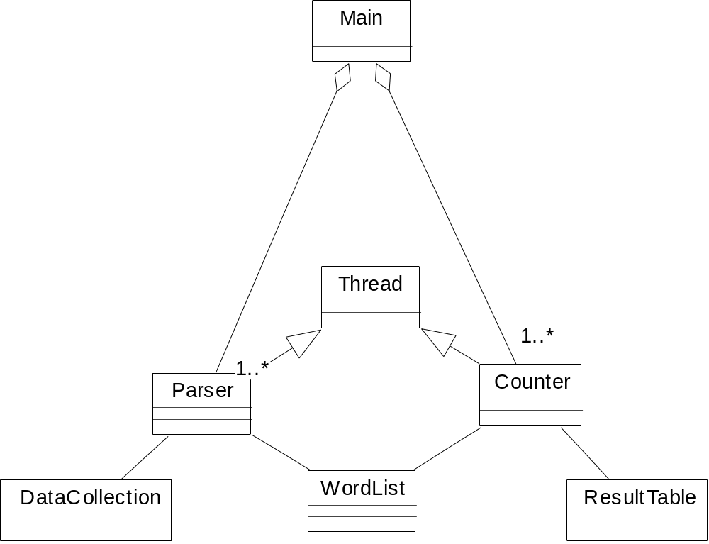
Improve Word Counter for Performance
No
No need for lock
web | 2
weed | 1
green | 2
sun | 1
moon | 1
land | 1
part | 1
Data
collection
Separate counters
KEY | web | weed | green | sun | moon | land | part | web | green | …….
VALUE

Slide 11
Peta-scale Data
Data
collection
web | 2
weed | 1
green | 2
sun | 1
moon | 1
land | 1
part | 1
KEY | web | weed | green | sun | moon | land | part | web | green | …….
VALUE

Slide 12
Addressing the Scale Issue
Single machine cannot serve all the data: you need a distributed special (file) system
Large number of commodity hardware disks: say, 1000 disks 1TB each
  Issue: With Mean time between failures (MTBF) or failure rate of 1/1000, then at least 1 of the above 1000 disks would be down at a given time.
  Thus failure is norm and not an exception.
  File system has to be fault-tolerant: replication, checksum
  Data transfer bandwidth is critical (location of data)
Critical aspects: fault tolerance + replication + load balancing, monitoring
Exploit parallelism afforded by splitting parsing and counting
Provision and locate computing at data locations

Slide 13
Peta-scale Data
Data
collection
web | 2
weed | 1
green | 2
sun | 1
moon | 1
land | 1
part | 1
KEY | web | weed | green | sun | moon | land | part | web | green | …….
VALUE

Slide 14
Peta Scale Data is Commonly Distributed
Data
collection
Data
collection
web | 2
weed | 1
green | 2
sun | 1
moon | 1
land | 1
part | 1
Data
collection
Data
collection
Data
collection
Issue: managing the
large scale data
KEY | web | weed | green | sun | moon | land | part | web | green | …….
VALUE

Slide 15
Write Once Read Many (WORM) data
Data
collection
Data
collection
web | 2
weed | 1
green | 2
sun | 1
moon | 1
land | 1
part | 1
Data
collection
Data
collection
Data
collection
KEY | web | weed | green | sun | moon | land | part | web | green | …….
VALUE

Slide 16
WORM Data is Amenable to Parallelism
Data
collection
Data
collection
Data with WORM characteristics : yields to parallel processing;
Data without dependencies: yields to out of order processing
Data
collection
Data
collection
Data
collection

Slide 17
Divide and Conquer: Provision Computing at Data Location
One node
For our example,
#1: Schedule parallel parse tasks
#2: Schedule parallel count tasks
Data
collection
This is a particular solution;
Lets generalize it:
Our parse is a mapping operation:
MAP: input → <key, value> pairs
Our count is a reduce operation:
REDUCE: <key, value> pairs reduced
Map/Reduce originated from Lisp
But have different meaning here
Runtime adds distribution + fault tolerance + replication + monitoring +
load balancing to your base application!
Data
collection
Data
collection
Data
collection

Slide 18
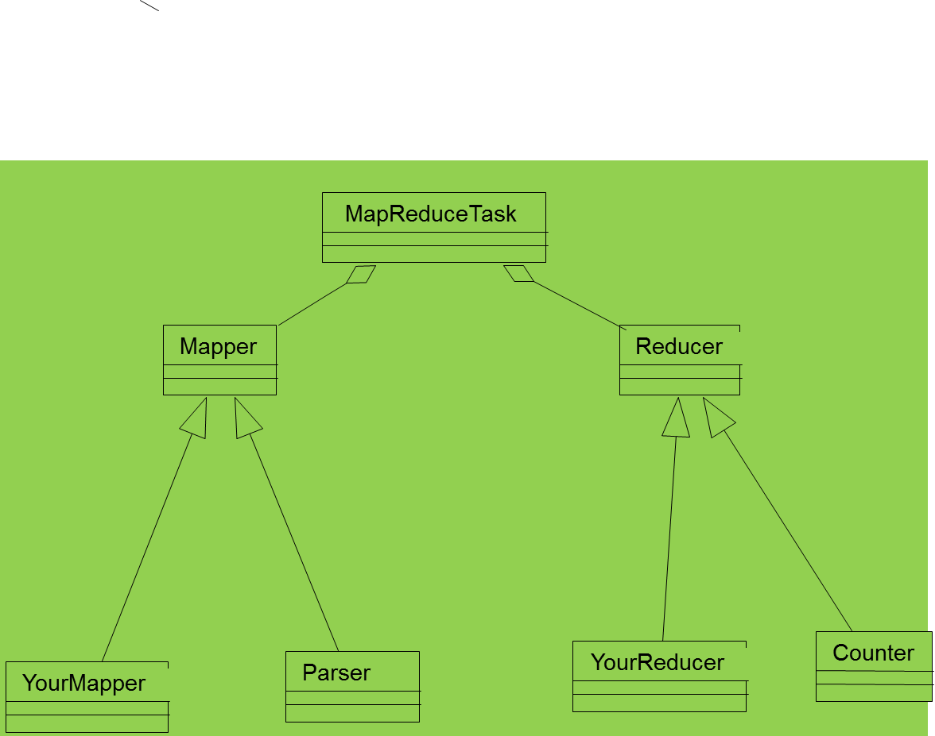
Mapper and Reducer
Remember: MapReduce is simplified processing for larger data sets: MapReduce Version of WordCount Source code

Slide 19
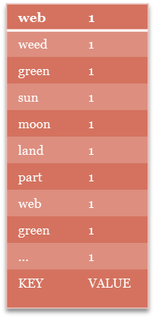
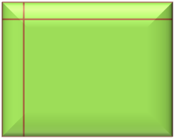
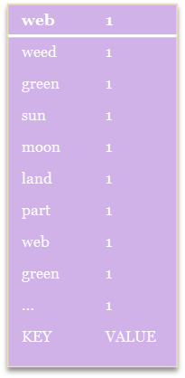

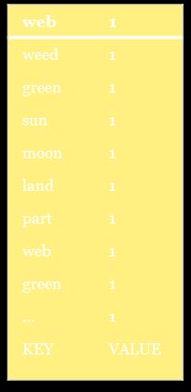
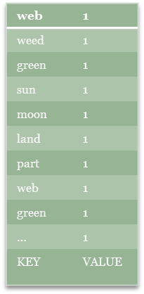
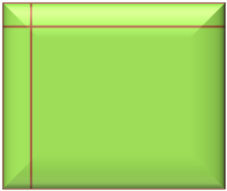
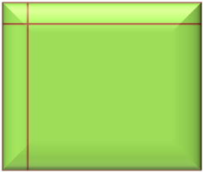
Map Operation
web | 1
weed | 1
green | 1
sun | 1
moon | 1
land | 1
part | 1
web | 1
green | 1
… | 1
KEY | VALUE
MAP: Input data ➔ <key, value> pair
Map
Data
Collection: split1
Split the data to
Supply multiple
processors
Data
Collection: split 2
Map
……
…
Data
Collection: split n

Slide 20
Reduce Operation
MAP: Input data ➔ <key, value> pair
REDUCE: <key, value> pair ➔ <result>
Map
Reduce
Data
Collection: split1
Split the data to
Supply multiple
processors
Reduce
Data
Collection: split 2
Map
……
…
Data
Collection: split n
Map
Reduce

Slide 21
Large scale data splits
Map <key, 1>
Reducers (say, Count)
Parse-hash
Count
P-0000
, count1
Parse-hash
Count
P-0001
, count2
Parse-hash
Count
P-0002
Parse-hash
,count3

Slide 22
MapReduce Example in my operating systems class
Cat
Bat
Dog
Other
Words
(size:
TByte)
combine
reduce
map
part0
split
reduce
combine
split
map
part1
combine
reduce
split
map
part2
split
map

Slide 23
MapReduce Programming Model

Slide 24
MapReduce programming model
Determine if the problem is parallelizable and solvable using MapReduce (ex: Is the data WORM?, large data set).
Design and implement solution as Mapper classes and Reducer class.
Compile the source code with hadoop core.
Package the code as jar executable.
Configure the application (job) as to the number of mappers and reducers (tasks), input and output streams
Load the data (or use it on previously available data)
Launch the job and monitor.
Study the result.
Detailed steps.

Slide 25
MapReduce Characteristics
Very large scale data: peta, exa bytes
Write once and read many data: allows for parallelism without mutexes
Map and Reduce are the main operations: simple code
There are other supporting operations such as combine and partition (out of the scope of this talk).
All the map should be completed before reduce operation starts.
Map and reduce operations are typically performed by the same physical processor.
Number of map tasks and reduce tasks are configurable.
Operations are provisioned near the data.
Commodity hardware and storage.
Runtime takes care of splitting and moving data for operations.
Special distributed file system. Example: Hadoop Distributed File System and Hadoop Runtime.

Slide 26
Classes of problems “mapreducable”
Benchmark for comparing: Jim Gray’s challenge on data-intensive computing. Ex: “Sort”
Google uses it (we think) for wordcount, adwords, pagerank, indexing data.
Simple algorithms such as grep, text-indexing, reverse indexing
Bayesian classification: data mining domain
Facebook uses it for various operations: demographics
Financial services use it for analytics
Astronomy: Gaussian analysis for locating extra-terrestrial objects.
Expected to play a critical role in semantic web and web3.0

Slide 27
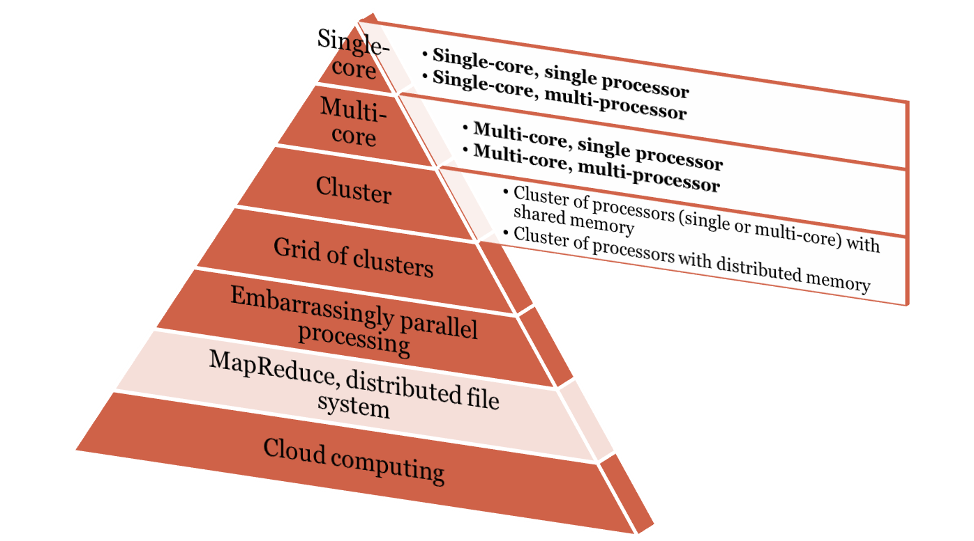
Scope of MapReduce
Data size: small
Pipelined Instruction level
Concurrent Thread level
Service Object level
Indexed File level
Mega Block level
Virtual System Level
Data size: large

Slide 28
Hadoop

Slide 29
What is Hadoop?
At Google MapReduce operation are run on a special file system called Google File System (GFS) that is highly optimized for this purpose.
GFS is not open source.
Doug Cutting and Yahoo! reverse engineered the GFS and called it Hadoop Distributed File System (HDFS).
The software framework that supports HDFS, MapReduce and other related entities is called the project Hadoop or simply Hadoop.
This is open source and distributed by Apache.

Slide 30
Basic Features: HDFS
Highly fault-tolerant
High throughput
Suitable for applications with large data sets
Streaming access to file system data
Can be built out of commodity hardware

Slide 31
Hadoop Distributed File System
HDFS Server
Master node
HDFS Client
Application
Local file system
Block size: 2K
Name Nodes
Block size: 128M
Replicated
More details: We discuss this in great detail in my Operating
Systems course

Slide 32
Hadoop Distributed File System
HDFS Server
Master node
blockmap
HDFS Client
heartbeat
Application
Local file system
Block size: 2K
Name Nodes
Block size: 128M
Replicated
More details: We discuss this in great detail in my Operating
Systems course

